Slide 1
Read My Novel - An Online Reading and Writing Platform
Group 4:
Lê Minh Hải Phong -
Lê Hồng Minh - 20176820
Nguyễn Bình Long -

Slide 2
Content
1. Description
2. Use case diagram
3. Design
4. Technology stacks
5. Project structure
6. Demo

Slide 3
Description
This project aims at developing an online reading and writing platform, called Read My Novel
Through this website, authors can write books by posting chapters and choose to publish their writing to public community
Each user can read some book for free or buy each chapter of a book to read if he/she is interested. Moreover, users can write book reviews, comment on chapters or vote for their favorite books

Slide 4
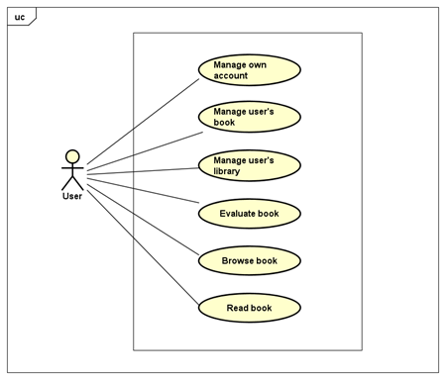
Usecase diagram
General usecase
diagram:

Slide 5
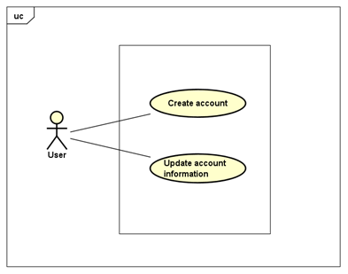
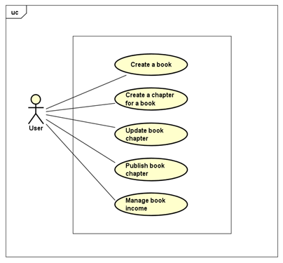
Other usecase diagram
Manage own account
Manage user’s book

Slide 6
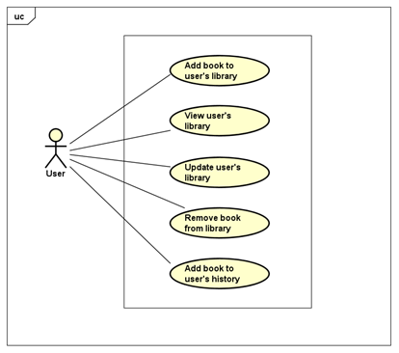
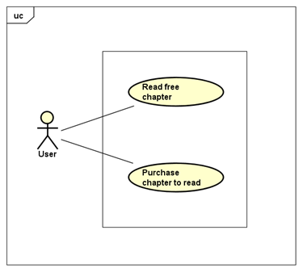
Other usecase diagram
Manage user’s library
Read book

Slide 7
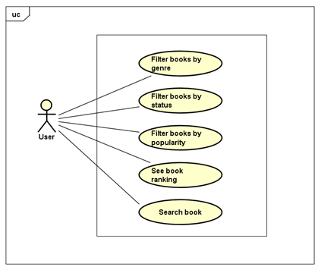
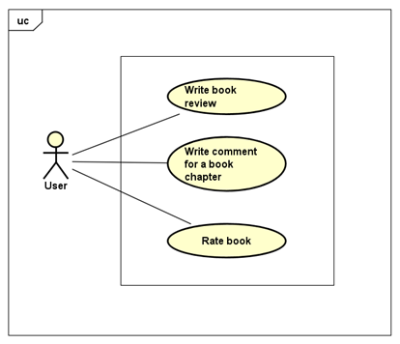
Other usecase diagram
Browse book
Evaluate book

Slide 8
Design
UI design
- The website is responsive, which can run on desktop screen (screens equal to or greater than 1200px wide) and display well on mobile screens (screens less than 768px wide)
The design of UI is based on https://www.webnovel.com/

Slide 9
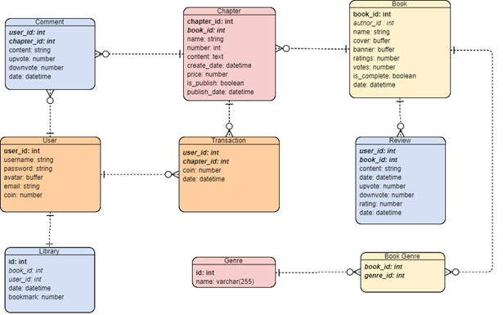
Design
Database design
DBMS: MongoDB
Relational schema:

Slide 10
Technology stacks
React
Redux
ExpressJS

Slide 11
Technology stacks
React
React is a Javascript library that aims to simplify development of visual interfaces. Developed by Facebook and released to the world in 2013, it drives some of the most widely used code in the world
Its primary goal is to make it easy to reason about an interface and its state in any point in time, by dividing the UI into a collection of components

Slide 12
Technology stacks
Redux
Redux is a predictable state container for JavaScript apps. As the application grows, it becomes difficult to keep it organized and maintain data flow. Redux solves this problem by managing application’s state with a single global object called Store
Principles of Redux: Predictability of Redux is determined by three most important principles as given below
+ Single Source of Truth
+ State is Read-only
+ Changes are made with pure functions

Slide 13
Technology stacks
ExpressJS
ExpressJS is a web application framework that provides you with a simple API to build websites, web apps and back ends
It enables you to create a web server that is more readable, flexible, and maintainable than you would be able to create using only the Node HTTP library, which can get verbose and complicated for even the most basic web servers

Slide 14
Project structure
Models: store model of DB
Config: store all configurations of project
Middlewares: functions that run after a request is received but before the route handler function
Node modules
Route: contains all API of the project
Client: Actions, Components, Reducer

